Slide 1

Git and GitHub workshop
By Christian Dave Empinado

Slide 2

Have you ever...
painstakingly compressed the same files over and over again?
Shared coding files through email or messenger?
Lost track of your changes or edited on the wrong version of the files?
Git and GitHub are here!

Slide 3
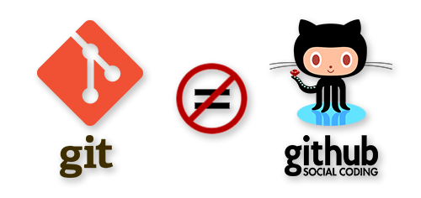
Git and GitHub are NOT THE SAME!

Slide 4
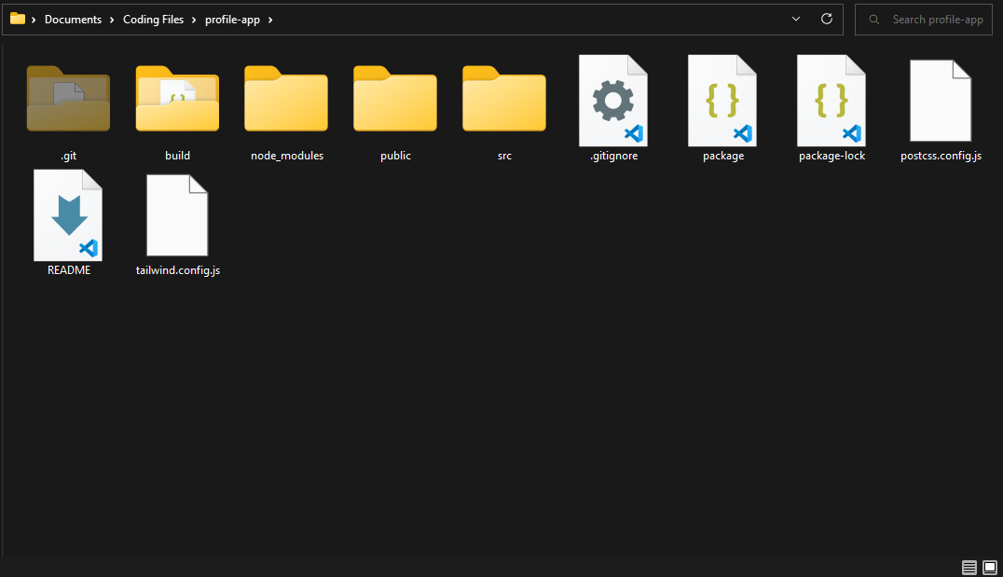
Introduction to Git and version control
What is Git?
Git is a free and open-source distributed version control system.
Designed to handle everything from small to very large projects with speed and efficiency.
Version Control
A way to manage files and directories.
Track changes over time and can recall previous versions.
A Git repository tracks and saves the history of all changes made to the files in a Git project.

Slide 5
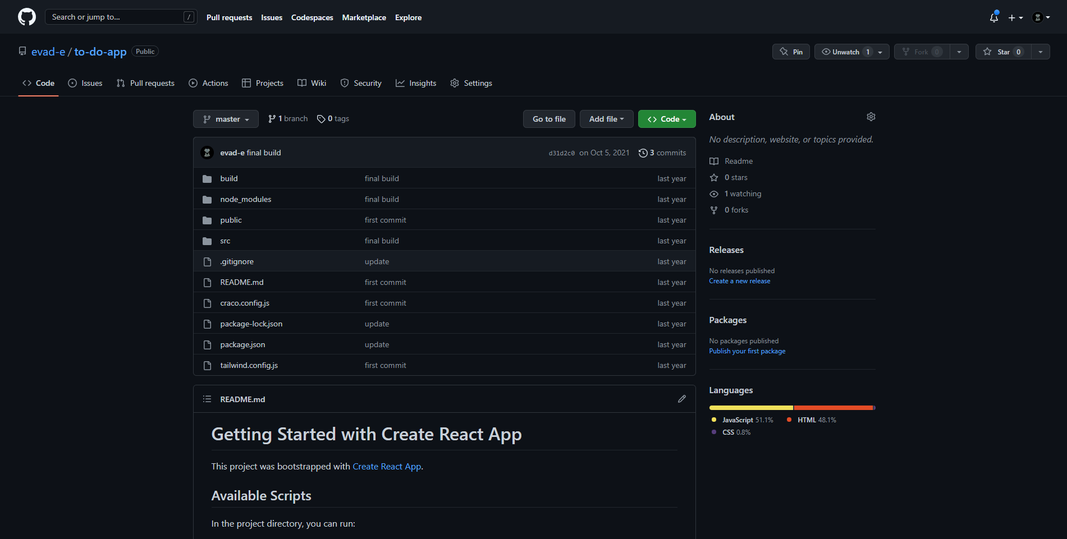
Introduction to GitHub
What is GitHub?
GitHub is a website that hosts Git repositories on a remote server
While Git takes care of the underlying version control, GitHub is the collaboration platform built on top of it.
Hosting repositories on GitHub facilitates the sharing of codebases among teams
GitHub, Bitbucket, Azure Repos

Slide 6
Git vs. GitHub
Git
GitHub
A software
Git is installed locally on the system
Manages different versions of edits
Allows code sharing
It is a service
Hosted on the web
Has built-in user management feature
Focused on centralized source code hosting

Slide 7
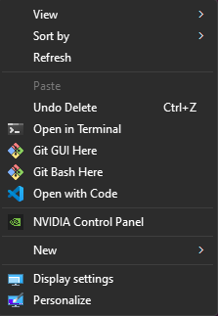
Starting with git
Install Git through this link: https://git-scm.com/downloads
Open the git command-line interface for windows called Git Bash by right clicking on your desktop and clicking Git Bash Here

Slide 8
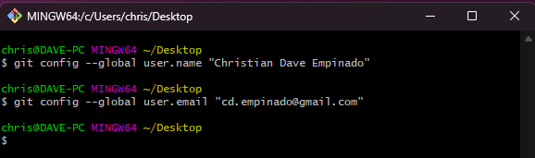
Configuring git
To set up Git with your name
git config –-global user.name “YOUR NAME HERE”
To set up Git with your email
git config –-global user.email “YOUR EMAIL HERE”

Slide 9
We are ready to make our first repository!

Slide 10
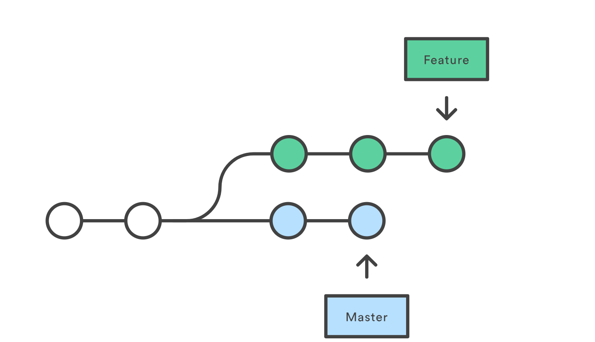
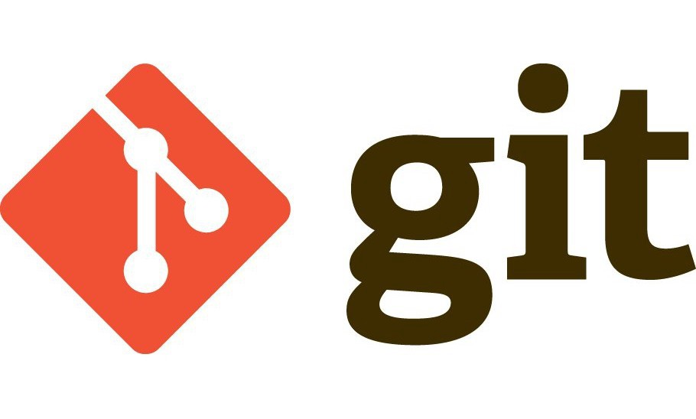
Before we start...
Tutorial Flow (Git)
Initializing a local repository with <git init>
Working with Git’s three-tree architecture
Working <git add>
Staging index <git commit>
Repository
Working with branches <git checkout>

Slide 11

Initializing a Local repository
Create a folder where you will have your code files.
Create your code file (it could be a simple HTML file for now).
Open Git Bash on the folder and run the code <git init>.
If you turn on your hidden items option, you can see a hidden folder named .git
CONGRATULATIONS! You have created a Git repository.

Slide 12
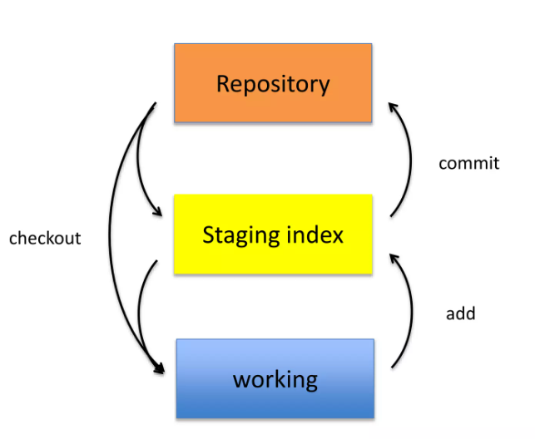
Working with Git’s Three-Tree Architecture
Git works in three levels:
Working: this is where all work is done in the repository.
Staging index: changes are “staged” before being recorded or reflected.
Repository: this is where the changes are recorded and stored.

Slide 13
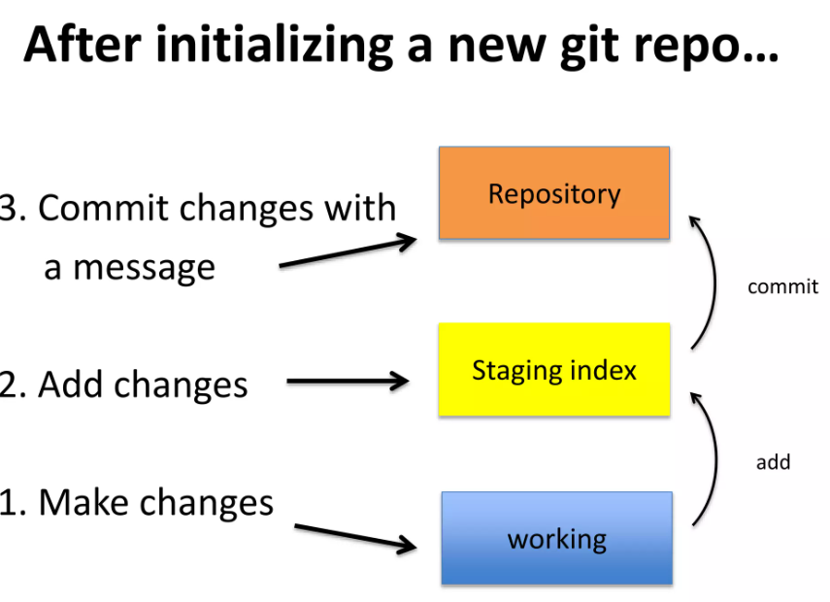
Working with Git’s Three-Tree Architecture
<git add [FILE]> is the command to stage a file with changes.
To add all files, we can use <git add .>
<git commit> is the command to commit or “save” the changes.
A good practice is to always commit with a message that describes the changes made.
We can do this in one command through: <git commit –m “commit message”>

Slide 14
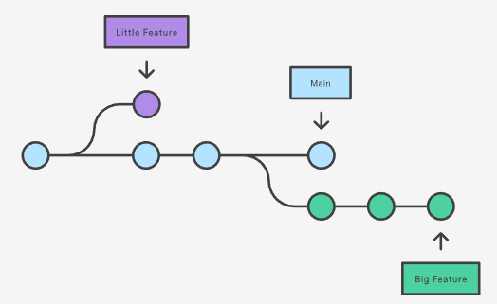
Working with branches
There will be times where you would want to experiment with unstable code.
Git branches are effectively a pointer to a snapshot of your changes. When you want to add a new feature or fix a bug—no matter how big or how small—you spawn a new branch to encapsulate your changes.
This makes it harder for unstable code to get merged into the main code base

Slide 15
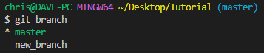
Working with branches
We can view our branches through the command <git branch>.
To create a new branch, run <git branch [NEW BRANCH NAME]>.
To delete a branch, run <git branch –d [BRANCH NAME]>.
To transfer your workflow to another branch use, <git checkout [BRANCH NAME]>.
You may use <git checkout -b [NEW BRANCH NAME]> to create a new branch and then transfer to the new branch.

Slide 16
Recap
<git init> to initialize a local repository.
Git’s three-tree architecture
<git add [FILE]> to “stage” files.
<git commit –m [COMMIT MESSAGE]> to commit files with a message to the repository.
Working with branches
<git branch> to view your branches
<git branch [NEW BRANCH NAME]> to create a new branch
<git branch –d [BRANCH NAME]> to delete a branch
<git checkout [BRANCH NAME]> to transfer your workflow to another branch.

Slide 17

GitHub basics

Slide 18

Before we start...
Tutorial Flow (GitHub)
Setting up your account
Creating a remote repository
Linking a local repository to a GitHub repository
Pushing and Pulling files from a remote repository
Collaboration

Slide 19
Setting up your account
Go to https://github.com/ to set up your GitHub account.
I suggest you use your personal or professional email for this.
You may also enroll your school email to get student perks. (ex. GitHub pro account).

Slide 20
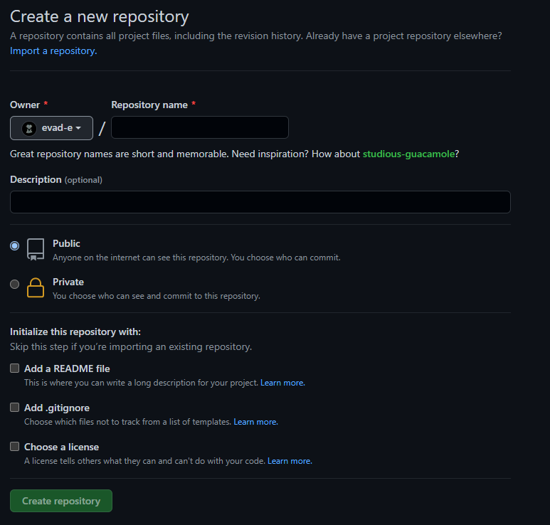


Creating a remote repository
Sign in with your GitHub account.
Click
Type in your repository name (make it short but sweet)
Click
You may add collaborators to your GitHub repo
Go to settings > click Manage Access.
Click Add people and search their name, username or email.

Slide 21
Adding to your GitHub repository
There are two ways we can connect to a GitHub repository:
Creating a GitHub repository and then “cloning” it to your computer.
Creating a local repository first then adding your GitHub repository as a remote repository.

Slide 22
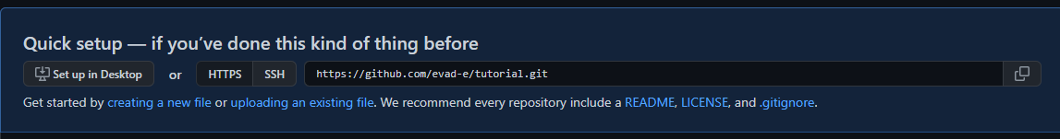
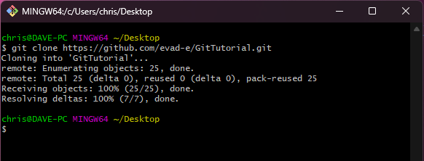
Cloning a GitHub repository
Copy the link of your new repository.
Open Git Bash on your computer and run the command <git clone [remote url]>.

Slide 23
Adding a remote repository
Copy the link of your repository.
Go to your local repository and run these commands:
<git remote add [name] [remote url]>.

Slide 24
Pushing and pulling
The <git push [remote] [branch]> command is used to upload local repository content to a remote repository.
The <git pull [remote] [branch]> is used to fetch and download content from a remote repository and immediately update the local repository to match that content.

Slide 25

Collaboration begins!
When development begins, you may commit changes and push to your remote repository. Just run the commands that was introduced a while ago.
If there are changes made on the remote repository, you would need to run <git pull [remote] [branch]>.
To ensure you are up to date with your codebase, git pull should be run before interacting with your code.

Slide 26

Conflicts
If you are collaborating, conflicts are bound to happen.
Conflicts generally arise when two people have changed the same lines in a file, or if one developer deleted a file while another developer was modifying it.
Git does not know which change is correct and will flag these as conflicts.

Slide 27
Branching with GitHub
Through branching and merging we can avoid conflicts as much as possible.
Branches allow you to develop features, fix bugs, or safely experiment with new ideas in a contained area of your repository.
Typically, you create a new branch from the default branch of your repository usually the “master” branch.

Slide 28
Pull Requests and review
Pull requests let you tell others about changes you've pushed to a branch in a repository on GitHub.
When opening a "pull request", you are making a "request" that the project repository "pull" changes from your branch.
Git checks whether the files could be merge between two branches.
After you create a pull request, you can ask a specific person to review the changes you've proposed.
Reviews allow collaborators to comment on the changes proposed in pull requests, approve the changes, or request further changes before the pull request is merged.
After your pull request has been reviewed, it can be merged into the default branch.

Slide 29
RECAP
We created a remote repository through GitHub and linked that repository to a local repository
<git push [remote] [branch]> command is used to upload local repository content to a remote repository.
<git pull [remote] [branch]> is used to fetch and download content from a remote repository and immediately update the local repository to match that content.
Conflicts generally arise when two people have changed the same lines in a file, or if one developer deleted a file while another developer was modifying it.
Through branching we can avoid conflicts as much as possible.
Pull requests let you tell others about changes you've pushed to a branch in the GitHub repository.

Slide 30
tips
Commit small, push big.
Utilize .gitignore.
If git bash is too tiresome for you, there are other tools such as GitHub desktop and VS Code source control.
Make it a habit to not modify the main/master branch directly. Use branches!
Delete a merged branch after merging.
Pull before you start coding. If a merge occurs, inform your other teammates about it so they may pull the changes as well.

Slide 31
Where to go from here?
Make it a habit to use Git and GitHub in your next projects.
Learn about:
Git LFS - Git for big large file systems, usually used for game development.
CI/CD - Continuous Integration/Continuous Development
GitHub Actions - Automate checking whether the pull requests works or not.
Apply project management methods in your development such as SDLC, Waterfall etc.
Have fun!

Slide 32

Any Questions?

Slide 33
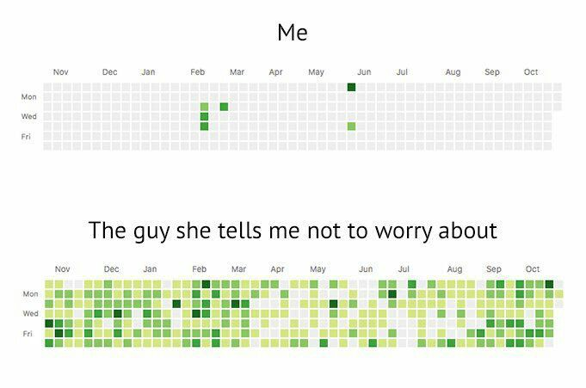
Thank you for joining!

